Slide 1
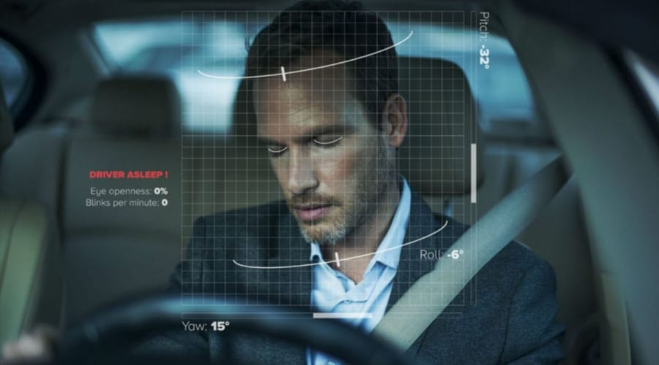
DRIVER DROWSINESS DETECTION SYSTEM

Slide 2
Problem Statement
THE GOAL OF THIS PROJECT IS TO DEVELOP A REAL-TIME DRIVER DROWSINESS DETECTION SYSTEM USING PYTHON THAT CAN ACCURATELY IDENTIFY SIGNS OF DRIVER FATIGUE AND ALERTNESS.
THE SYSTEM WILL UTILIZE COMPUTER VISION TECHNIQUES AND MACHINE LEARNING ALGORITHMS TO MONITOR THE DRIVER'S FACIAL FEATURES AND BEHAVIOR,DETERMINING THEIR LEVEL OF ALERTNESS.

Slide 3
BRIEF DESCRIPTION
ONE OF THE MOST COMMON CAUSES OF ACCIDENTS IS DRIVER DROWSINESS AND FATIGUE.EACH YEAR THE NUMBER OF PEOPLE KILLED IN SUCH ACCIDENTS RISES AROUND THE WORLD.
WITH THIS PROJECT WE WILL BE MAKING A DROWSINESS SYESTEM TO MONITOR AND ASSESS DRIVER'S LEVEL OF ALERTNESS.
THUS THE PRIMARY OBJECTIVE OF THIS TECHNOLOGY IS TO ENHANCE ROAD SAFETY BY IDENTIFYING INSTANCES WHEN A DRIVER'S ATTENTION IS WANING OR THEY ARE BECOMING DANGEROUSLY DROWSY.HENCE REDUCING THE RISK OF ACCIDENTS CAUSED BY DRIVER FATIGUE.

Slide 4
BRIEF DESCRIPTION
THE APPROACH WE WILL BE USING FOR THIS PROJECT IS AS FOLLOWS:
1.TAKE IMAGE AS INPUT FROM A CAMERA
2.DETECT THE FACE IN IMAGE AND CREATE A REGION OF INTEREST
3.DETECT THE EYES AND FEED TO THE CLASSIFIER
4.CLASSIFIER WILL CATEGORIZE IF EYES ARE OPEN OR CLOSED
5.CALCULATE SCORE TO CHECK IF THE PERSON IS DROWSY

Slide 5
TECHNOLOGIES USED
COMPUTER VISION FOR FACIAL FEATURE RECOGNITION.
MACHINE LEARNING ALGORITHM FOR PATTERN RECOGNITION.
PYTHON WITH LIBRARIES:
OpenCV –For face and eye detection.
TensorFlow-Keras uses tensorflow as backend.
Keras –To build our classification model.

Slide 6
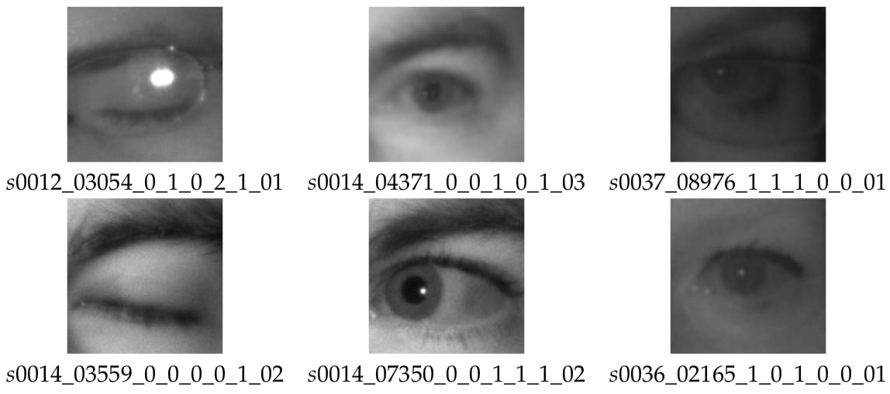
TECHNOLOGIES USED
DATASET [Taken from MRL]: There are about 84,898 images with properties like subject ID,image ID,gender,glasses,eye state,reflections,lighting conditions and sensor ID.

Slide 7
TECHNOLOGIES USED
MODEL ARCHITECTURE: CNN [Convolution Nueral Networks] is commonly used in driver drowsiness detection systems due to thier ability to effectively analyze and process visual data such as images and video frames.
-Inception model of CNN is used for feature extraction,efficiency and robustness.
HAAR CASCADE ALGORITHM: This algorithm uses a set of simple rectangular features to detect objects based on thier characteristic features such as edges,corners or texture variations.

Slide 8
ADVANTAGES
THE USE OF DRIVER DROWSINESS DETECTION SYSTEM OFFERS SEVERAL SIGNIFICANT ADVANTAGES:
-ACCIDENT PREVENTION: One of the primary advantages of driver drowsiness detection system is its ability to prevent accidents caused by drowsy driver.
-QUICK DETECTION OF DROWSINESS and ENHANCED DRIVER AWARENESS: The warnings and alerts generated by these systems serve as reminders for drivers to stay alert and engaged while driving.

Slide 9
ADVANTAGES
-REAL TIME MONITORING: These systems continuously monitor the driver's behavior and physiological indicators in real time.
This dynamic monitoring ensures that the system can adapt its warning based on the drivers changing condition, providing more accurate results
-ABLE TO DISTINGUISH BETWEEN NORMAL EYE BLINKS AND DROWSY EYES

Slide 10
FUTURE SCOPE
THE FUTURE SCOPE OF DRIVER DROWSINESS DETECTION SYSTEM HOLDS SIGNIFICANT POTENTIAL DUE TO ONGOING ADVANCEMENTS IN TECHNOLOGY AND INCREASING CONCERNS ABOUT ROAD SAFETY.AS TECHNOLOGY CONTINUES TO EVOLVE,THESE SYSTEMS CAN HAVE SEVERAL IMPROVEMENTS WHICH MAY INCLUDE ADVANCEMENTS LIKE:
SENSOR INTEGRATION :Driver drowsiness can be enhanced with more advanced sensors, such as camera that monitor facial expressions ,heartbeat and body movements.

Slide 11
FUTURE SCOPE
REAL-TIME FEEDBACK AND INTERVENTION : This include a more advanced technology that could automatically adjust the vehicle's settings, such as playing the music, vibrating the steering wheel to wake up the driver etc.
SMART WEARABLES AND CONNECTIVITY : Wearable devices such as smartwatches or headsets could become more integrated with these systems. They might provide additional data inputs like body temperature and stress levels to improve the accuracy.

Slide 12
THANK YOU

